Slide 1

Online Book Store

Slide 2
CONTENTS
What is Online Book Store
Objectives
Requirements
Operations
Screen Shots
Data structure Screen Shots
Advantages
Conclusion

Slide 3
What is Online Book store?
Online Book Store is an online application Where the customer can purchase books Online. Through a web browser the customer can browse wide range of books from books, later can add to the shopping cart and finally Order to their address.
This application admin can perform CRUD operations like Adding , Deleting , Updating books

Slide 4
Objective
The Main objective of “Online Book Store “ is to provide an essence of online book store via a simple and yet powerful medium.
The project has been designed to stimulate the working of an actual online book store.
This Project provide simple UI for user so that user can easily access web site .

Slide 5
Requirements
Hardware requirement
1) 8 GB of RAM
2) I5 core Processor
Software requirement
1) Microsoft Visual Studio 2019
2) SQL Server
3) Wamp Server
Operating System
1) Windows 10

Slide 6
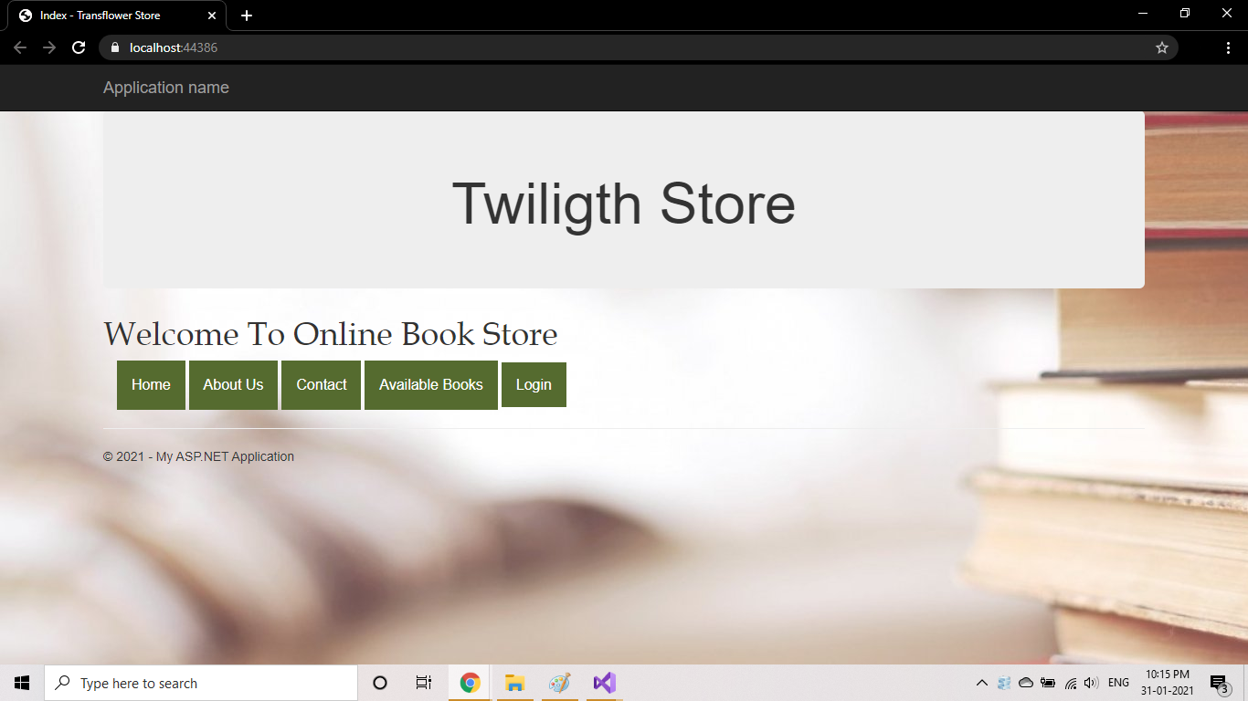
Screen Shot :- 1 Home Page

Slide 7
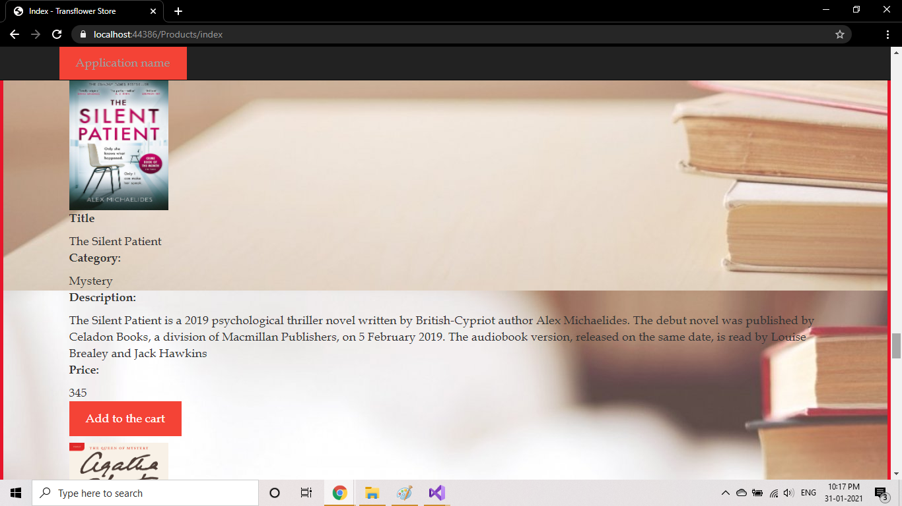
Screen shot :- 2 Books

Slide 8
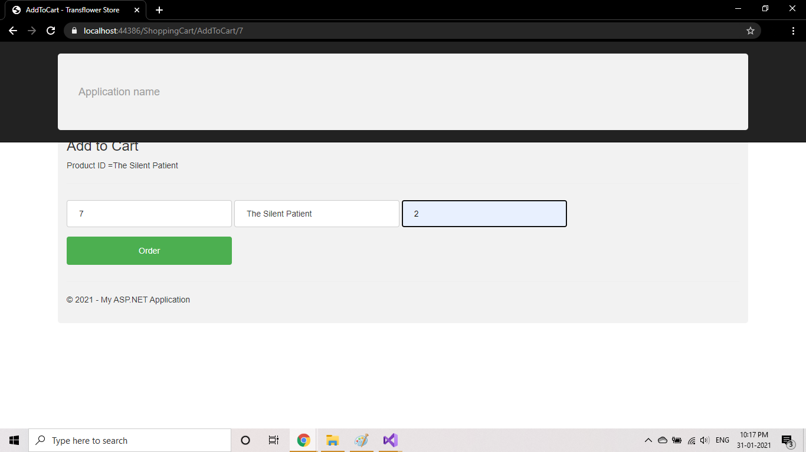
Screen Shot :- 3 Add to Cart

Slide 9
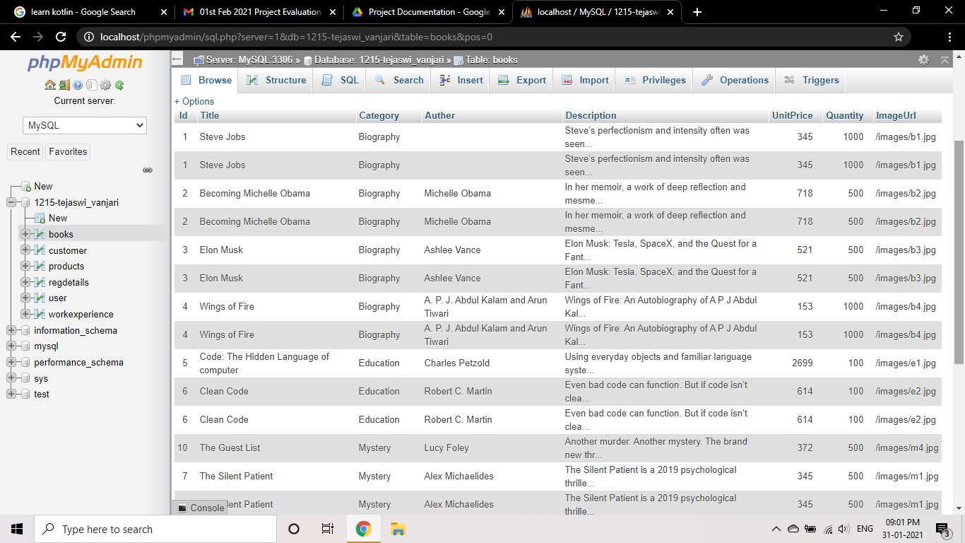
Screen Shots :- 4 Data structure

Slide 10
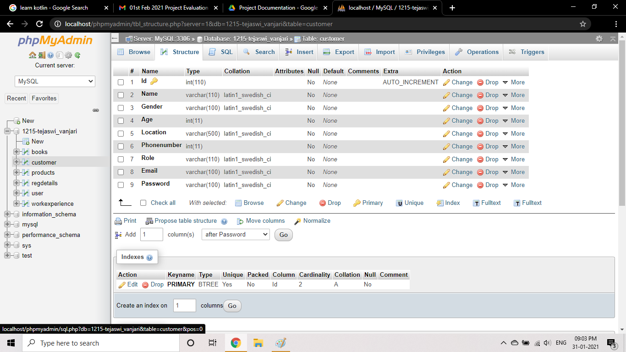
Screen Shots :- 5 Data structure

Slide 11
Advantages
Cost Saving
Time saving
Fast purchasing
View books of all categories
Home Delivery

Slide 12


